Slide 1


A to Z
of
Council Services

Slide 2
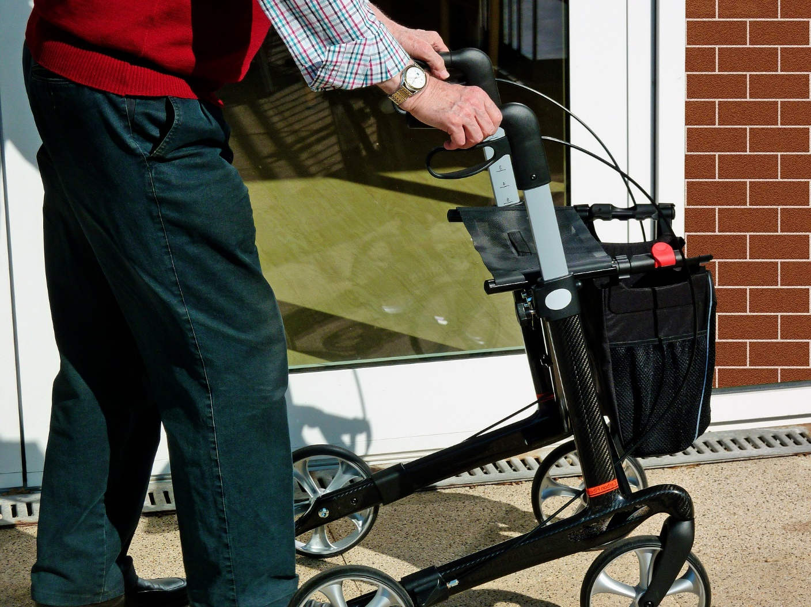
A is for Adult Social Care

Slide 3
Shropshire’s population of older people is growing faster than the national average. Shropshire’s 65+ population is 23% of the total population. By 2025, Shropshire will be home to over 89,100 people over the age of 65.
18.6% of Shropshire’s population have a limiting long term illness (census 2011). By 2025 27% of those aged 65 or over (19,544 people) will have long term illness which limits their day-to-day activities a lot.
Between 2014/15 and 2015/16 requests for social care support through the Council’s Customer Service Centre increased by 21%.

Slide 4

B is for benefits and advice

Slide 5
Shropshire Council supports people with:
  Council tax support
  Housing benefit
  Discretionary housing payments (DHP)
  Local support and prevention fund (LSPF)
Shropshire Council also commissions a number of local services to provide advice, advocacy and information services to people in need of support.
Welfare Reform is leading to an increase in the number of people seeking advice and support to manage changes.
Research suggests that the average loss per person as a result of Welfare Reform in the West Midlands is £490 a year. This is combined with an increase in the cost of living.

Slide 6
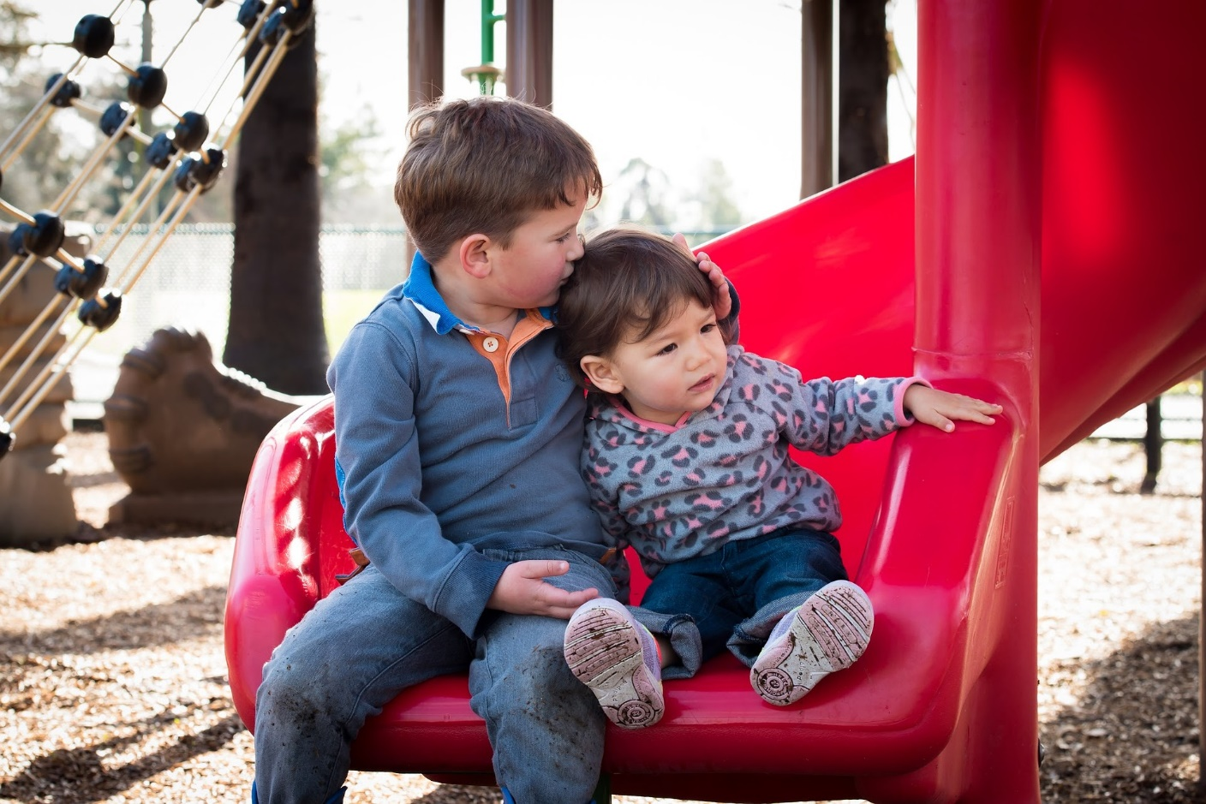
C is for children’s services

Slide 7
Shropshire Council provides social care for children and families, this includes:
  Specialist child protection and safeguarding services.
  Care services such as foster care, leaving care, young carers and adoption services.
  Mental health support for children and young people.
  Information on services for disabled children and their families.
  Support within the community, for example, through Children’s Centres and Parenting advice.
  Early help and support to tackle issues before they develop.
  Support for families with more complex and multiple support needs.

Slide 8

D is for data and research

Slide 9
Shropshire Council works to collect data about individuals, and communities. We use that data to:
  Better support people and their families
  Understand local issues and needs
  Set priorities and make decisions
  Forecast and plan for the future
The Council works to protect sensitive data. This means that when you share your personal data with us it is kept securely and in line with legislation such as the Data Protection Act.

Slide 10
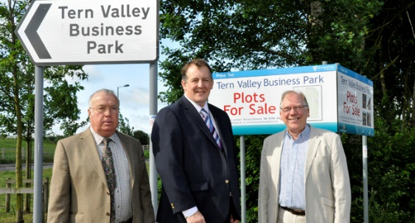
E is for economic growth

Slide 11
Shropshire Council developed a new Economic Growth Strategy in 2017 to set out ambitions for the years ahead.
Shropshire's economy is work £6.1 billion (Gross Value Added).
60% of Shropshire’s population are of working age (16 – 64).
Shropshire is home to 15,480 businesses. Most are small and 12,000 employ 4 people or less.
Connecting Shropshire has provided access to superfast broadband to 54,336 premises.

Slide 12
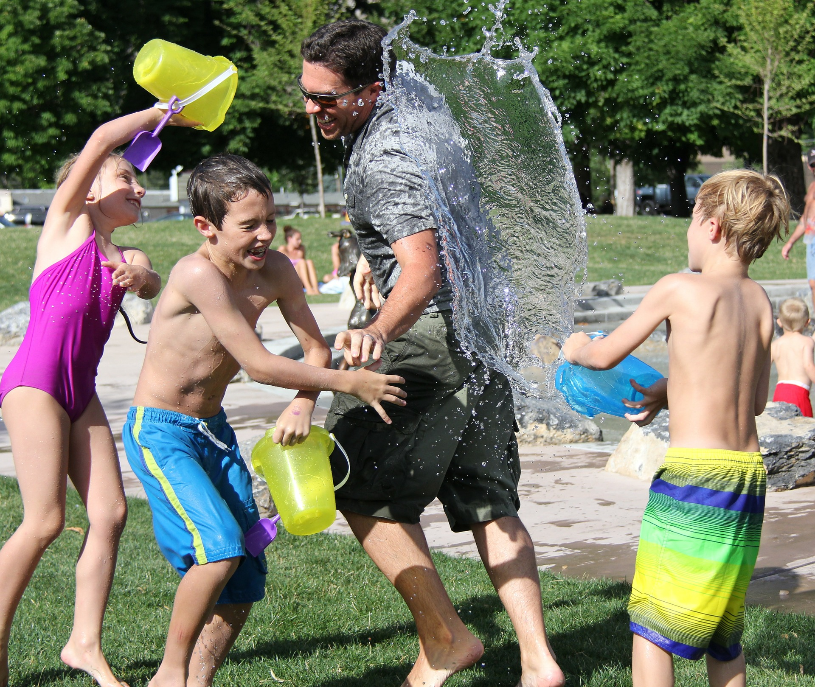
F is for families

Slide 13
Shropshire Council’s Strengthening Families programme aims to support families who might need extra help to be happy, healthy and safe. Support is provided to overcome multiple problems.
Shropshire Council’s Early Help also has a family focus. The Council works with schools and other organisations to identify and overcome problems early.
Children’s Centres are based in local communities and offer a one stop shop for children under 5 and their families.
Parenting practitioners provide training and advice.
The Council's Fostering and Adoption services help provide a range of support and can help to build new families.

Slide 14

G is for genealogy & archives

Slide 15
6,000 people a year visit Shropshire Council’s archives service and many more access information from the website.
There are 5.5 miles (9 kilometres) of archives covering the history and pre- history of Shropshire.
Archives include local materials from the 12th century to yesterday’s Shropshire Star.
The Archives Service provides outreach services, events and a service for schools. Volunteers support paid staff in delivering a wide range of activities.

Slide 16
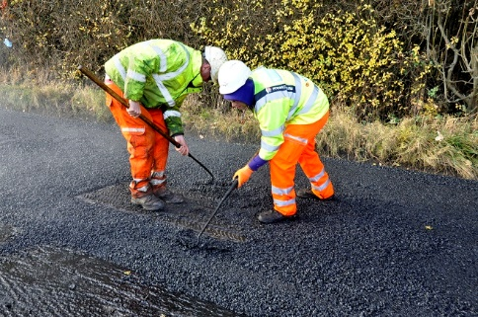
H is highways

Slide 17
It costs Shropshire Council £1.5 million a year to treat potholes and £9 million a year to resurface and surface dress the county’s roads.
We maintain a fleet of 25 gritters, 9 footway ploughs and 9 snow blowers.
We look after 1008 bridges.
Shropshire Council maintains 19,277 street lights and each one costs between £40 and £80 a year.

Slide 18
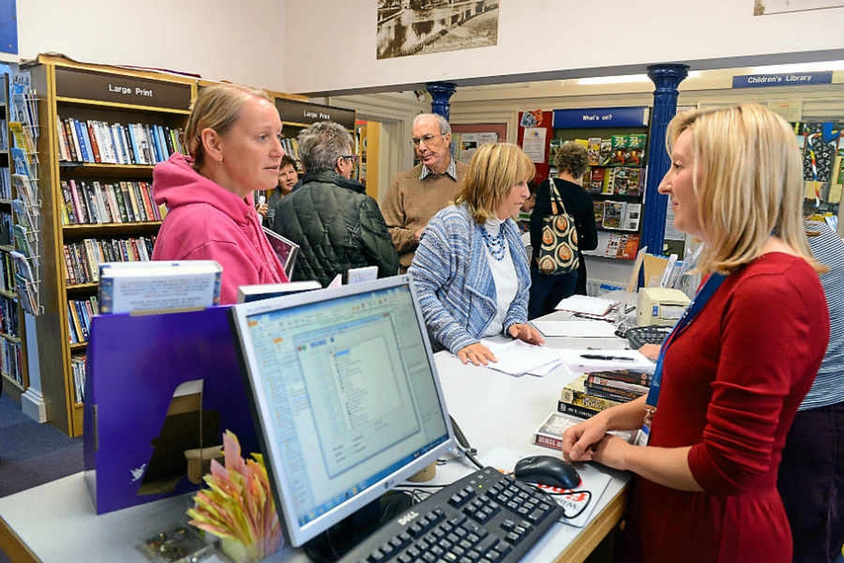
I is for information & advice

Slide 19
Our Customer Services department works hard to answer your questions. You can ask for help in a number of ways:
  By visiting a local information point – that may be your local library.
  Over the telephone.
  Using enquiry forms on our website.
  The information on our website may have the answers you are looking for.
  You can also write to us if you prefer.
Customer Services staff can also help by:
  Helping you get online.
  Helping you to fill in forms.
  Checking if you are eligible for a Council service.
  Signposting you to other forms of support.

Slide 20

J is for jobs, learning and skills

Slide 21
Shropshire Council focuses on skills and learning for all ages. Our services include:
  Working with providers of early years education (nurseries and pre-schools).
  School admissions
  Registering children in employment
  Support for children with special education needs
  Working with others to keep young people progressing through education.
  Provision of support for young people not in education, employment or training.
  Working with others to provide apprenticeships.
  Assessing skills needs among employers.
  Influencing the provision of adult education.

Slide 22
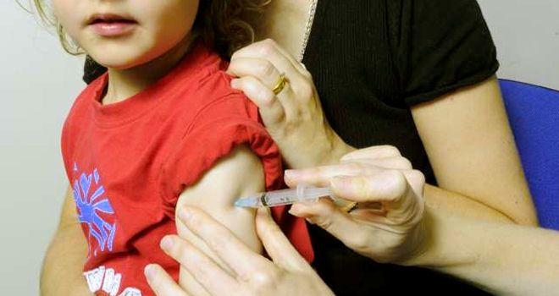
K is for keeping well: Public Health

Slide 23
Public health is about helping people to stay healthy, and protecting them from threats to their health.
This may be achieved through information and services to help people make healthier choices such as:
  Healthy eating
  Stopping smoking
  Preventing drug and alcohol misuse
  Keeping active
Public Health also works to minimise the risk and impact of illness this can include:
  Immunisations
  School nurses
  Health visitors
  Environmental protection
  Food safety
  …and many more…

Slide 24
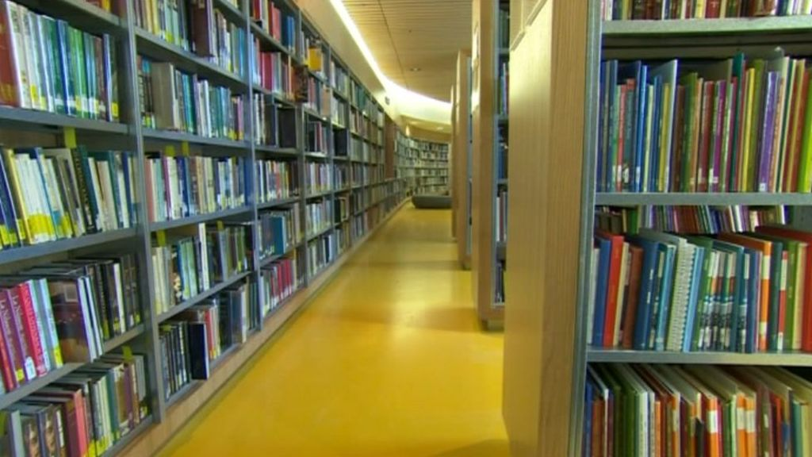
L is for libraries

Slide 25
Shropshire Council runs 6 main libraries, 7 community libraries and 4 mobile libraries. 8 libraries are now under community ownership.
There are over a million visits to libraries each year in Shropshire.
892,000 items were borrowed from Shropshire’s libraries last year (2016/17) including audio books, DVDs and e-books.
In 2016/17:
  library computers were used for 74,227 hours.
  38,226 people attended events in libraries.

Slide 26
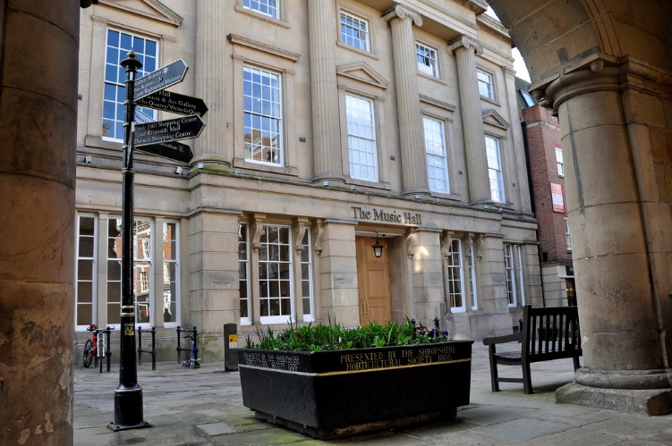
M is for museums & arts

Slide 27
Shropshire Museums look after over 250,000 museum objects.
The County Museum Service runs three museums, a museum resource centre and a mobile museum service:
  Acton Scott
  Ludlow Museum
  Ludlow Library and Museum Resource Centre
  Much Wenlock Museum
  Museum On The Move
The Arts Service supports arts bodies across the county and in 2015/16 secured over £3million of external and earned income.

Slide 28
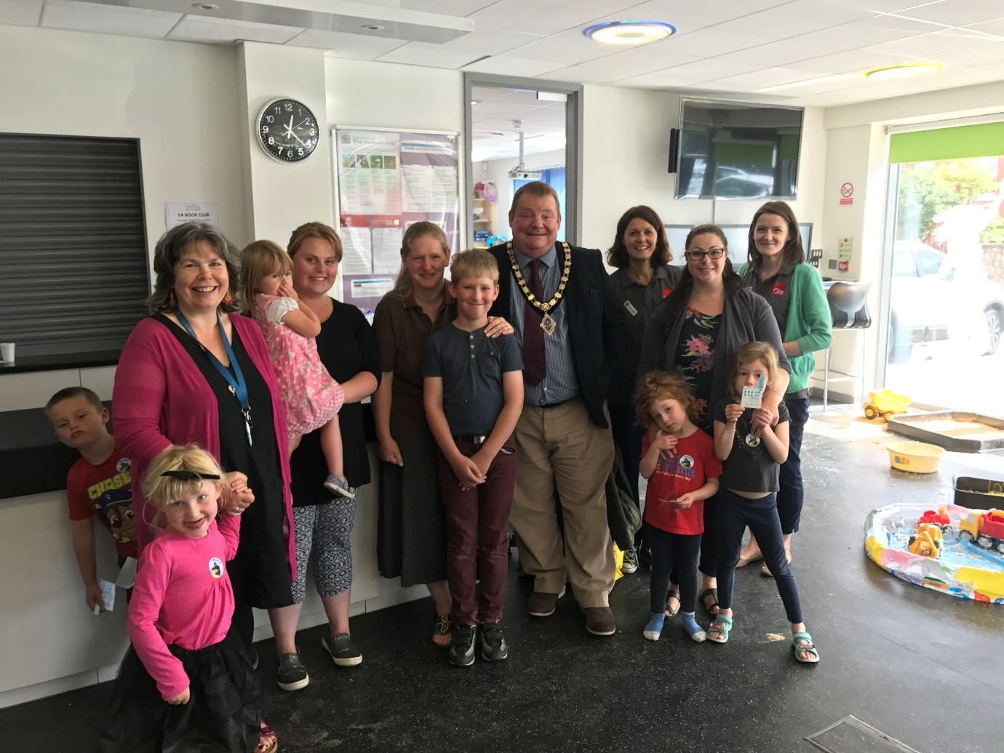
N is for neighbourhood support

Slide 29
Shropshire’s community enablement officers have an important role within local communities. They work to:
  Provide a link to Shropshire councillors and parish councils.
  Connecting people and groups to council services and other organisations.
  Offer advice on how to set up a group or develop a project.
  Help with searching for funding opportunities and making applications to funding bodies.
  Encourage communities to work together to develop new solutions to local issues.

Slide 30
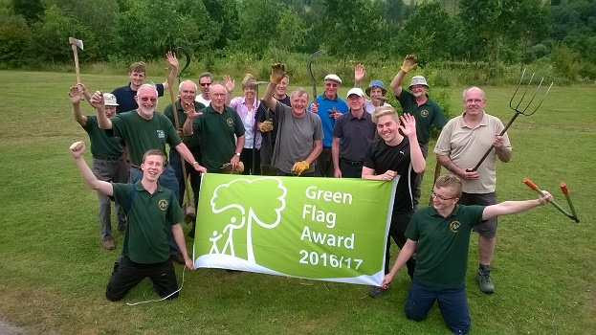
O is for outdoor recreation

Slide 31
Shropshire is home to 5,500 km of rights of way.
There are almost 1 million visits to Council managed parks and heritage sites every year.
Over 1,800 people participate in Walking for Health groups across the county.
The volunteers who support Shropshire Council to deliver its Outdoor Partnerships services provide the time equivalent to 21 extra full time members of staff.

Slide 32
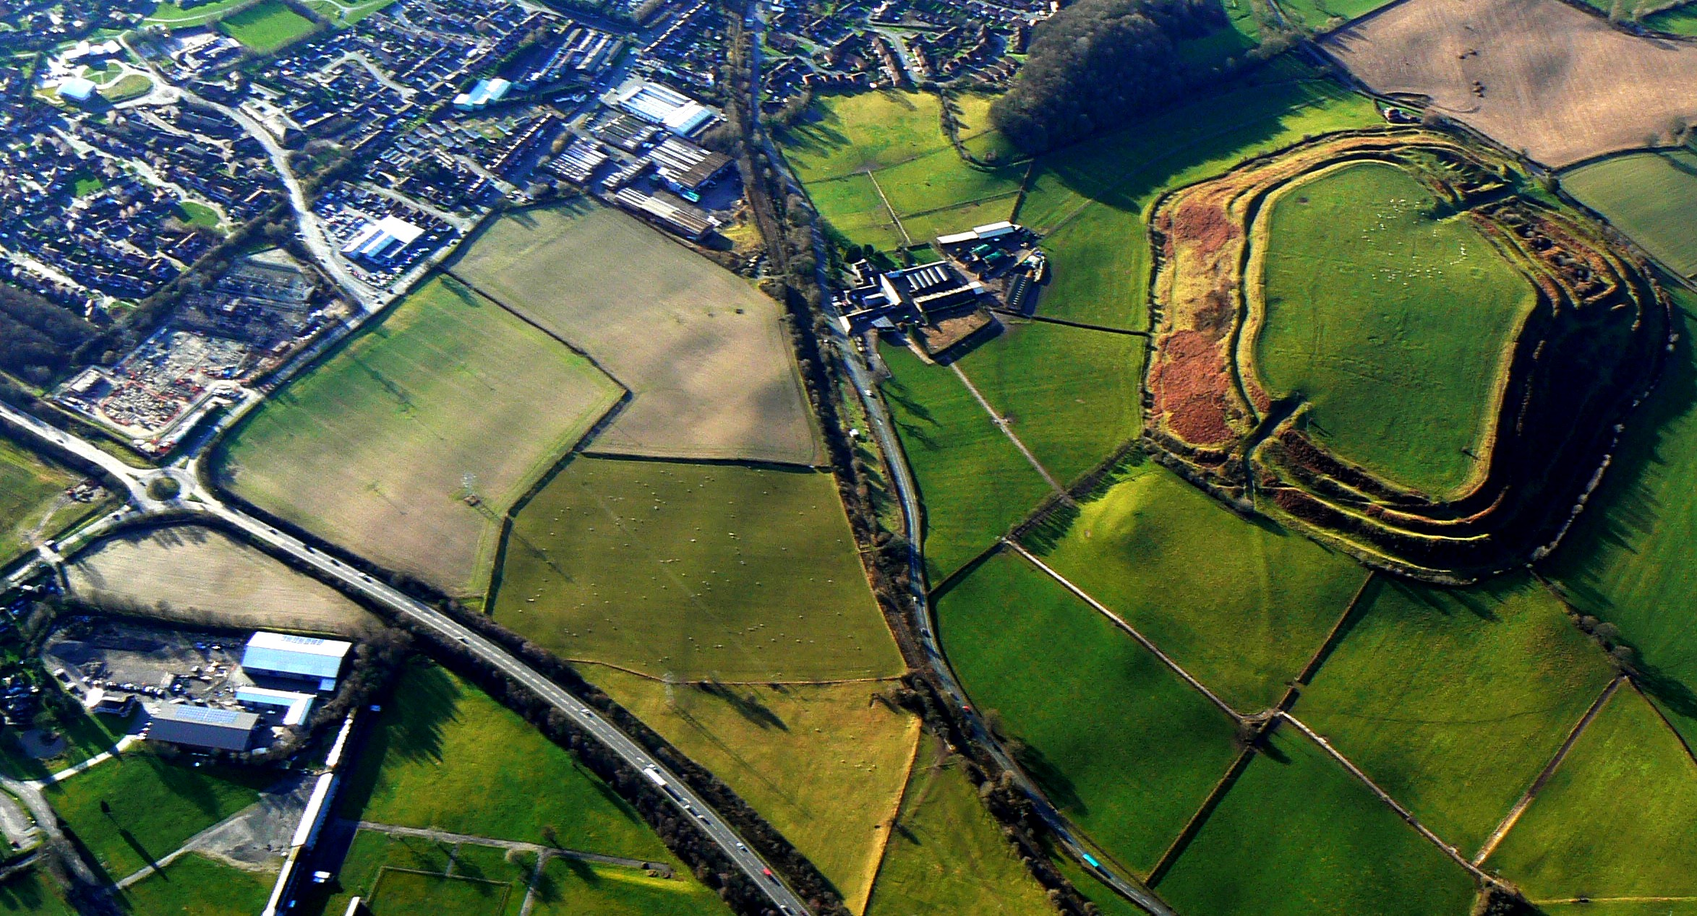
P is for planning

Slide 33
Planning policy is set out within the Local Plan. The Local Plan is made up of a number of planning documents, known as Local Development Documents (LDDs).
Shropshire Council is the second largest planning authority in the West Midlands outside of Birmingham.
18 Place Plans, Neighbourhood Plans, Town and Parish Plans, and other sources of information about local people, their communities and aspirations all inform the Local Plan.
27,500 new houses need to be completed by 2026. 1,402 were completed in 2015/16, 12% above the annual requirement.

Slide 34
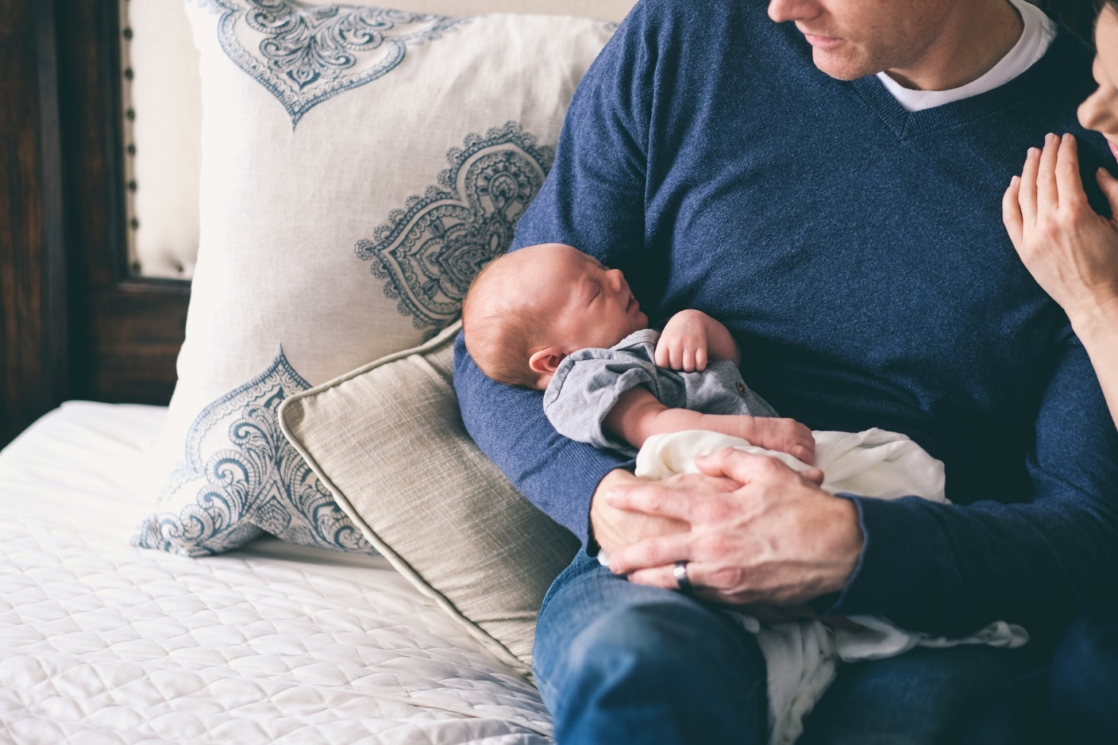
R is for registrars

Slide 35
Shropshire Council registers births and deaths.
Shropshire Council provides venues for ceremonies throughout Shropshire including:
  Weddings
  Vow renewal ceremonies
  Civil partnerships and civil partnership conversions
  Citizenship ceremonies
  Naming ceremonies
Shropshire Council is responsible for approving and licensing venues.
There are 65 registered venues across the county.

Slide 36
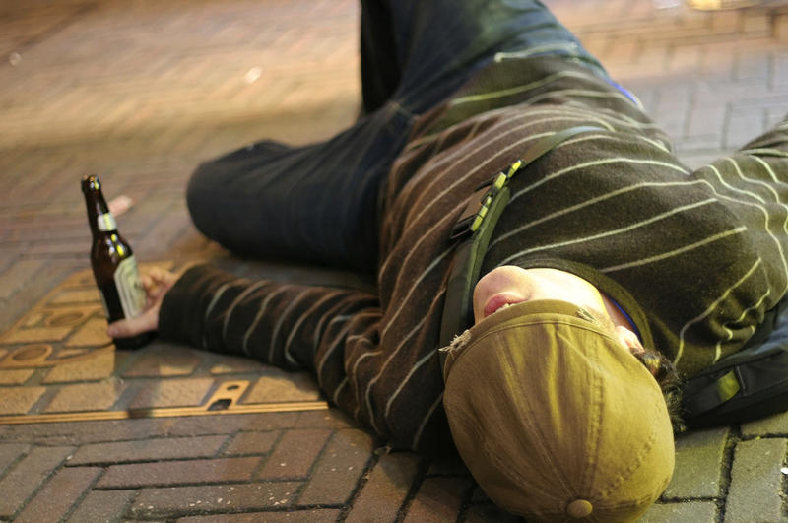
S is for safety & enforcement

Slide 37
Shropshire Council’s Environmental Health Officers, Health & Safety Team, Risk Management Team, Emergency Planning Team and others all work to keep the people of Shropshire safe in lots of different ways.
Public Protection teams also protect local people through the issuing of licenses for:
  Alcohol and entertainment
  Animals
  Gambling
  Taxis
  Street licenses and permits
  …and more…

Slide 38
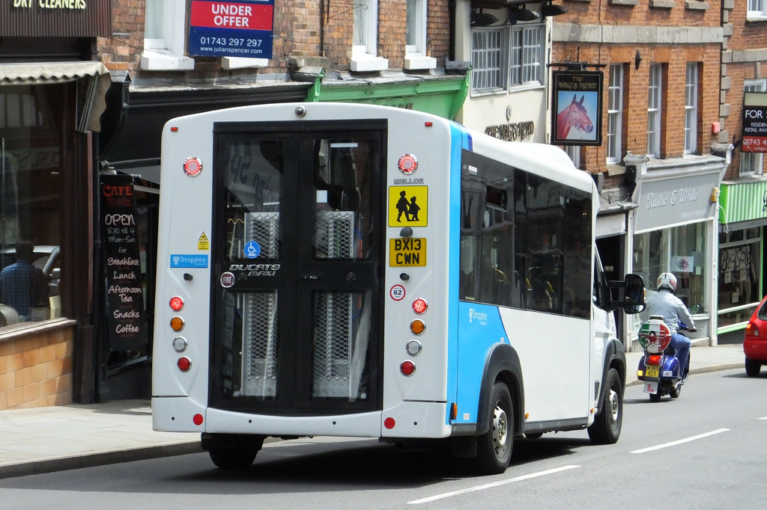
T is for transport

Slide 39
Shropshire Council manages the transportation of 7,000 school children each day to schools throughout Shropshire.
School transport is also enabled through Personal Transport Budgets and Independent Travel Training.
Local bus contracts allow 2 million passenger trips each year, getting people to and from work, college and essential services. This is supplemented by Community Transport.
There are 280 Council operated vehicles, from gritters, mobile libraries to minibuses and even snow blowers.

Slide 40
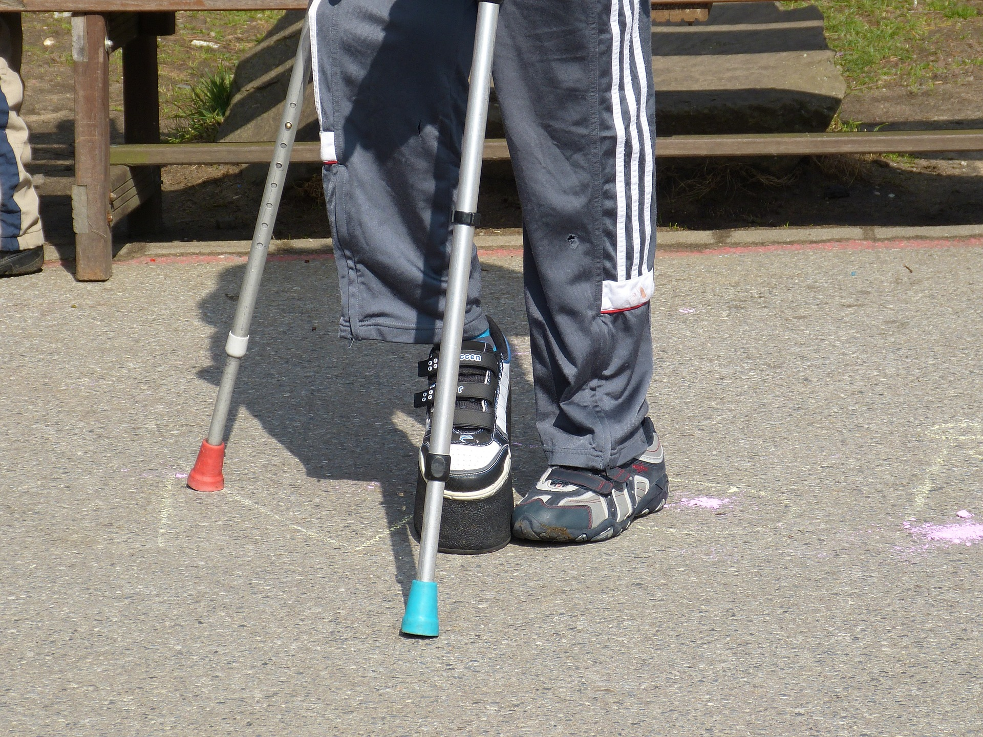
U is for understanding special needs

Slide 41
Shropshire’s SEND local offer helps families and professionals to support those with special educational needs or disabilities by providing information.
Shropshire Council commissions a number of local services that provide specialist support. You can find organisations through our Community Directory and Shropshire Choices website.
Shropshire Council’s Sensory Impairment Team works to support people with visual and/or hearing loss. The service offers assessments, support in registering an impairment and help with equipment.

Slide 42
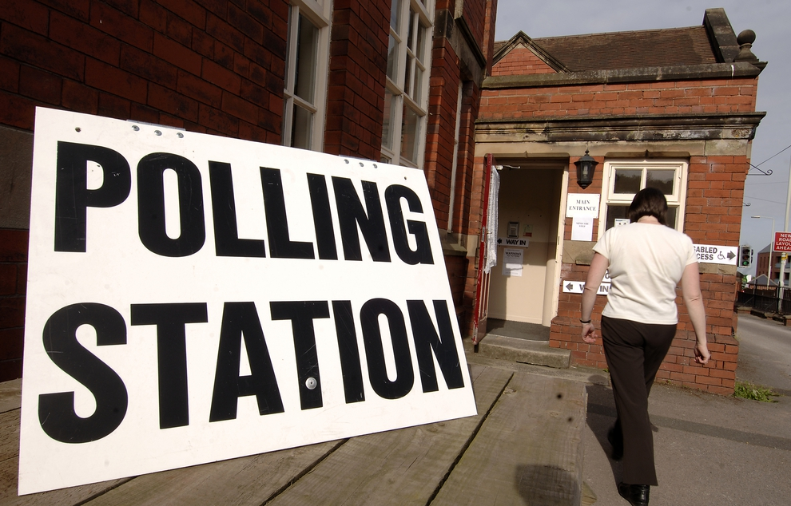
V is for voting & democracy

Slide 43
Shropshire Council writes to every household each year with a ‘housing enquiry form’. This provides information on who should be on the register of electors.
Shropshire Council manages local elections. The Elections Team is supported by many poll clerks, count assistants and presiding officers. These are the people you see at your local polling station.
Shropshire Council is led by 74 councillors, who set the vision and direction for the local community. Councillors are democratically elected to serve a four-year term of office.

Slide 44
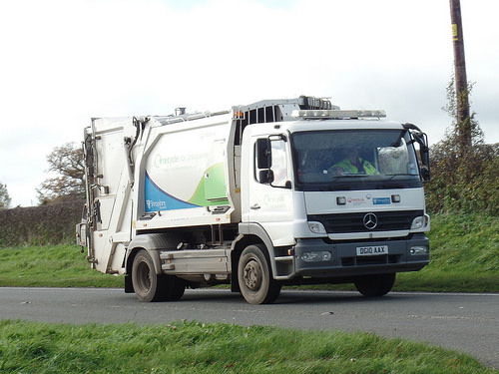
W is for waste & recycling

Slide 45
Shropshire Council ensures 10.5 million waste collections are undertaken in Shropshire every year.
53% of household waste is recycled or composted (86,000 tonnes).
There are 5 Household Recycling Centres (HRCs) recycling over 30 different types of materials.
Your rubbish is reused. Garden waste goes to local farms; Tudor Griffiths reuses hardcore and rubble; and West Midlands businesses recycle the cans, textiles, wood, batteries and small electrical items.

Slide 46
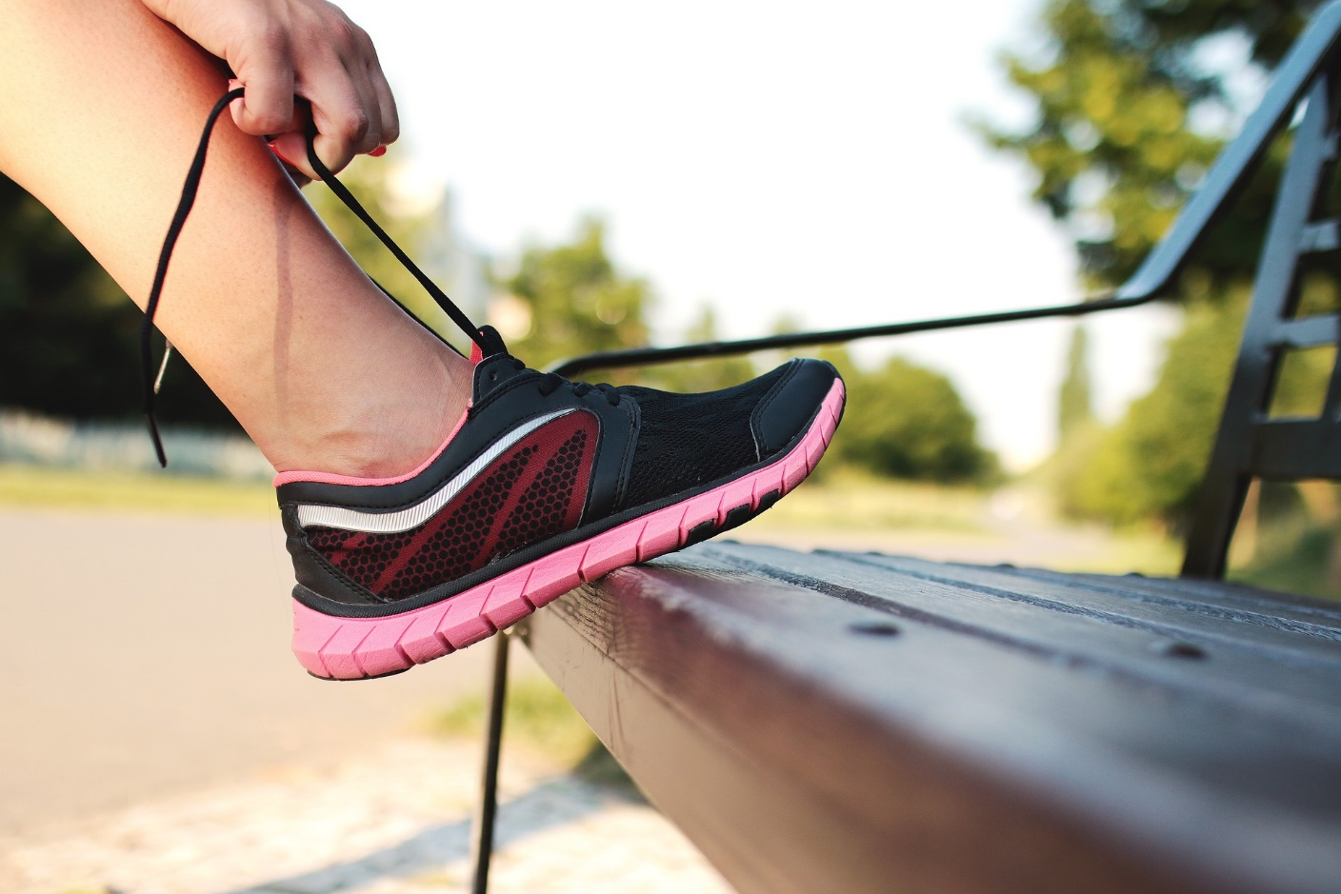
X is for eXercise & leisure

Slide 47
Shropshire Council commissions, directly manages or financially supports 24 leisure facilities in Shropshire.
The 24 facilities had 2,001,122 visits in 2016/17.
Shropshire is home to 84 sports halls, 207 badminton courts and 45 swimming pools.
Research suggests that 43.8% of Shropshire’s adults want to do more sport.

Slide 48
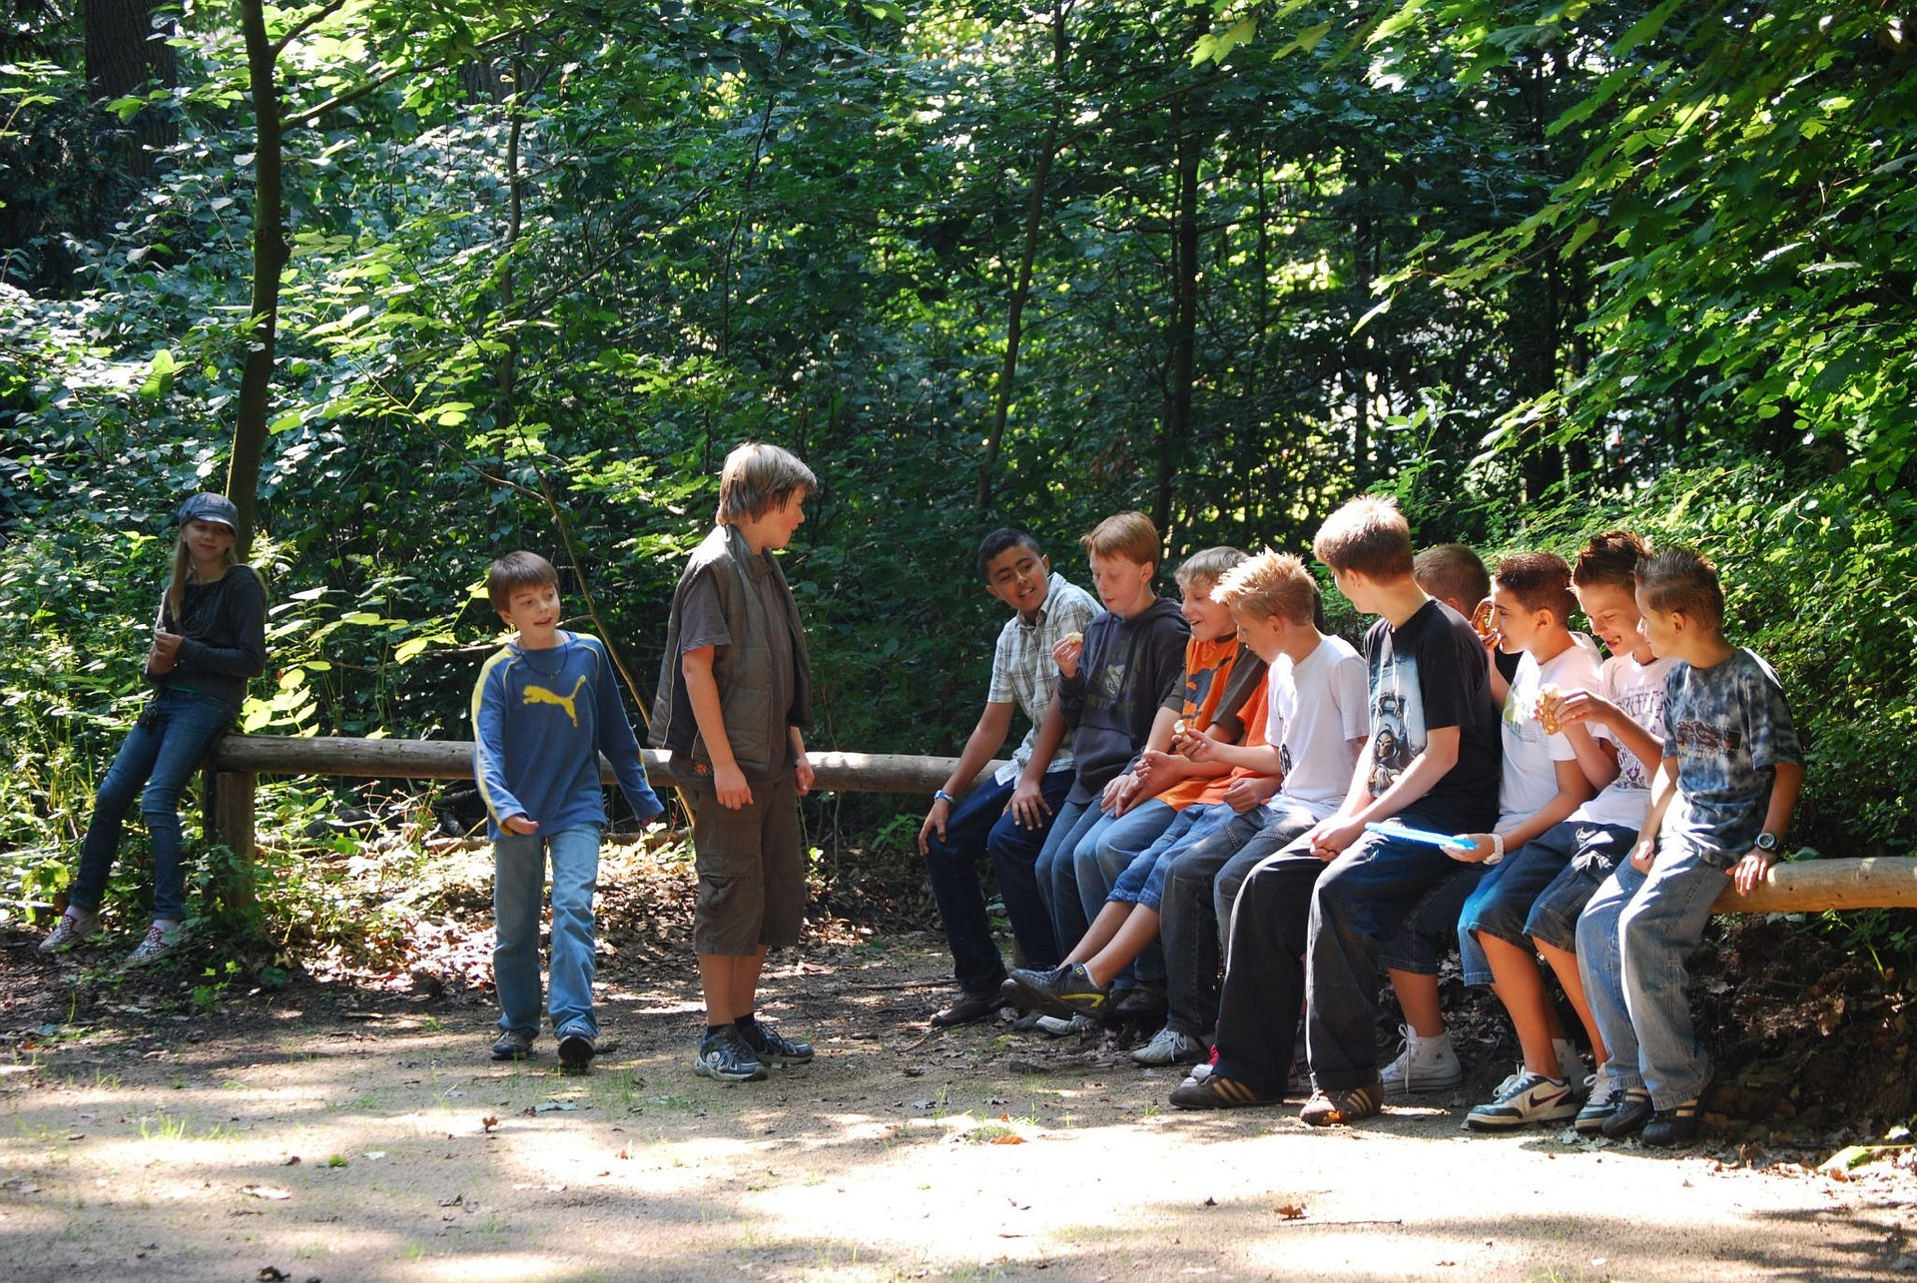
Y is for youth support

Slide 49
Shropshire Youth’s Information, Advice, Guidance & Transition Service delivers impartial guidance to young people in schools, colleges and other settings.
Targeted Youth Support (TYS) a specialist early intervention and prevention service for vulnerable young people aged 11-19. It aims to help people gain the resilience and skills they need to progress into adult life.
Shropshire Council supports the local commissioning of youth activities.
Shropshire Council commissions Shropshire Youth Association in partnership with Energize (the County Sports Partnership) to provide support for around 100 Shropshire youth clubs.

Slide 50

Z is for all the rest

Slide 51
Shropshire Council provides around 150 different services within the county. We have covered some of them in this A to Z but there are many more.
We also have services you don’t see – the ones that provide support to our front line services such as finance, legal, human resources and our IT services.
If you can any questions about our services don’t hesitate to get in touch. You can call our Customer Services on: 0345 678 9000
To find out more about the Big Conversation and offer your views on Shropshire Council email: big.conversation@shropshire.gov.uk

